Slide 1

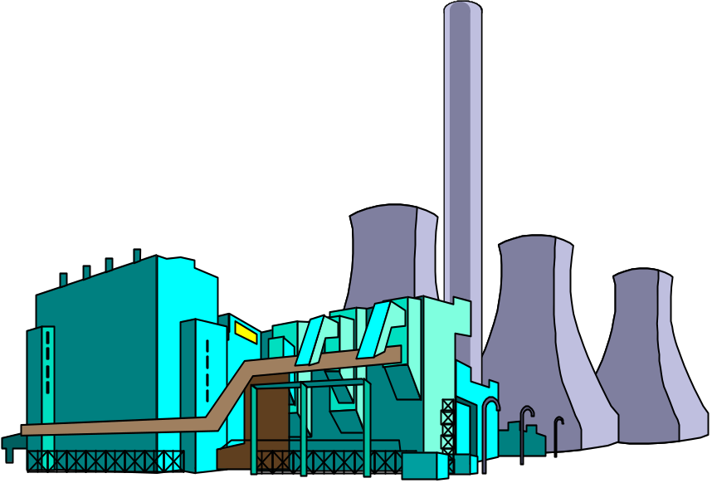

The Basics of Capital Budgeting/ Investment Appraisals
Should we
build this
plant?

Slide 2
What is capital budgeting?
Analysis of potential additions to fixed assets.
Long-term decisions; involve large expenditures.
Very important to firm’s future.

Slide 3
Steps to capital budgeting
Estimate CFs (inflows & outflows).
Assess riskiness of CFs.
Determine the appropriate cost of capital.
Find NPV and/or IRR.
Accept if NPV > 0 and/or IRR > WACC.

Slide 4
What is the difference between independent and mutually exclusive projects?
Independent projects – if the cash flows of one are unaffected by the acceptance of the other.
Mutually exclusive projects – if the cash flows of one can be adversely impacted by the acceptance of the other.

Slide 5
Proposed Project Data
  Julie Miller is evaluating a new project for her firm, Basket Wonders (BW). She has determined that the after-tax cash flows for the project will be $10,000; $12,000; $15,000; $10,000; and $7,000, respectively, for each of the Years 1 through 5. The initial cash outlay will be $40,000.

Slide 6
Independent Project
For this project, assume that it is independent of any other potential projects that Basket Wonders may undertake.
Independent -- A project whose acceptance (or rejection) does not prevent the acceptance of other projects under consideration.

Slide 7
Payback Period (PBP)
0 1 2 3 4 5
-40 K 10 K 12 K 15 K 10 K 7 K
PBP is the period of time required for the cumulative expected cash flows from an investment project to equal the initial cash outflow.

Slide 8
Payback Solution (#1)
(a)
0 1 2 3 4 5
(-b)
(d)
-40 K 10 K 12 K 15 K 10 K 7 K
(c)
10 K 22 K 37 K 47 K 54 K
Cumulative
Inflows
  PBP = a + ( b - c ) / d = 3 + (40 - 37) / 10 = 3 + (3) / 10 = 3.3 Years

Slide 9
Payback Solution (#2)
0 1 2 3 4 5
-40 K 10 K 12 K 15 K 10 K 7 K
-40 K -30 K -18 K -3 K 7 K 14 K
  PBP = 3 + ( 3K ) / 10K = 3.3 Years
  Note: Take absolute value of last negative cumulative cash flow value.
Cumulative
Cash Flows

Slide 10
What is the difference between normal and nonnormal cash flow streams?
Normal cash flow stream – Cost (negative CF) followed by a series of positive cash inflows. One change of signs.
Nonnormal cash flow stream – Two or more changes of signs. Most common: Cost (negative CF), then string of positive CFs, then cost to close project. Nuclear power plant, strip mine, etc.

Slide 11
What is the payback period?
The number of years required to recover a project’s cost, or “How long does it take to get our money back?”
Calculated by adding project’s cash inflows to its cost until the cumulative cash flow for the project turns positive.

Slide 12
Calculating payback
0
1
2
2.4
3
Project L
CF_{t} -100 10 60 100
80
Cumulative -100 -90 0 50
-30
30
80
Payback_{L} = 2 + / = 2.375 years
=
0
1
1.6
2
3
Project S
CF_{t} -100 70 100 20
50
Cumulative -100 0 20 40
-30
30
50
Payback_{S} = 1 + / = 1.6 years
=

Slide 13
Strengths and weaknesses of payback
Strengths
  Provides an indication of a project’s risk and liquidity.
  Easy to calculate and understand.
Weaknesses
  Ignores the time value of money.
  Ignores CFs occurring after the payback period.

Slide 14
Discounted payback period
Uses discounted cash flows rather than raw CFs.
0
1
2
2.7
3
10%
CF_{t} -100 10 60 80
PV of CF_{t} -100 9.09 49.59
60.11
Cumulative -100 -90.91 18.79
-41.32
Disc Payback_{L} = 2 + / = 2.7 years
=
41.32
60.11

Slide 15
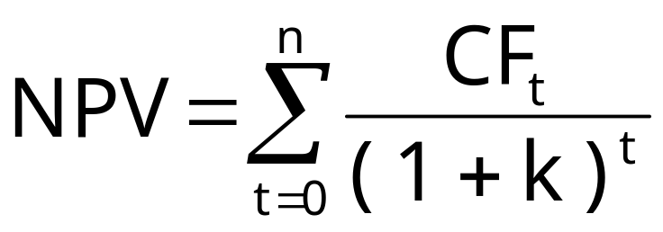
Net Present Value (NPV)
Sum of the PVs of all cash inflows and outflows of a project:

Slide 16
What is Project L’s NPV?
Year CF_{t} PV of CF_{t}
0 -100 -$100
1 10 9.09
2 60 49.59
3 80 60.11
NPV_{L} = $18.79
NPV_{S} = $19.98

Slide 17
Solving for NPV:
Financial calculator solution
Enter CFs into the calculator’s CFLO register.
  CF₀ = -100
  CF₁ = 10
  CF₂ = 60
  CF₃ = 80
Enter I/YR = 10, press NPV button to get NPV_{L} = $18.78.

Slide 18
Rationale for the NPV method
NPV = PV of inflows – Cost
= Net gain in wealth
If projects are independent, accept if the project NPV > 0.
If projects are mutually exclusive, accept projects with the highest positive NPV, those that add the most value.
In this example, would accept S if mutually exclusive (NPV_{s} > NPV_{L}), and would accept both if independent.

Slide 19
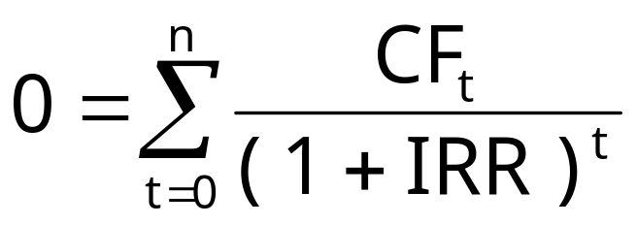
Internal Rate of Return (IRR)
IRR is the discount rate that forces PV of inflows equal to cost, and the NPV = 0:
Solving for IRR with a financial calculator:
  Enter CFs in CFLO register.
  Press IRR; IRR_{L} = 18.13% and IRR_{S} = 23.56%.

Slide 20
How is a project’s IRR similar to a bond’s YTM?
They are the same thing.
Think of a bond as a project. The YTM on the bond would be the IRR of the “bond” project.
EXAMPLE: Suppose a 10-year bond with a 9% annual coupon sells for $1,134.20.
  Solve for IRR = YTM = 7.08%, the annual return for this project/bond.

Slide 21
Rationale for the IRR method
If IRR > WACC, the project’s rate of return is greater than its costs. There is some return left over to boost stockholders’ returns.

Slide 22
IRR Acceptance Criteria
If IRR > k, accept project.
If IRR < k, reject project.
If projects are independent, accept both projects, as both IRR > k = 10%.
If projects are mutually exclusive, accept S, because IRR_{s} > IRR_{L}.

Slide 23
NPV Profiles
A graphical representation of project NPVs at various different costs of capital.
k NPV_{L} NPV_{S}
0 $50 $40
5 33 29
10 19 20
15 7 12
20 (4) 5

Slide 24
Drawing NPV profiles
NPV
($)
60
.
50
.
40
.
Crossover Point = 8.7%
.
30
.
.
IRR_{L} = 18.1%
20
.
.
S
10
L
.
IRR_{S} = 23.6%
.
.
0
Discount Rate (%)
5
10
15
20
23.6
-10

Slide 25
Comparing the NPV and IRR methods
If projects are independent, the two methods always lead to the same accept/reject decisions.
If projects are mutually exclusive …
  If k > crossover point, the two methods lead to the same decision and there is no conflict.
  If k < crossover point, the two methods lead to different accept/reject decisions.

Slide 26
Finding the crossover point
Find cash flow differences between the projects for each year.
Enter these differences in CFLO register, then press IRR. Crossover rate = 8.68%, rounded to 8.7%.
Can subtract S from L or vice versa, but better to have first CF negative.
If profiles don’t cross, one project dominates the other.

Slide 27
Reasons why NPV profiles cross
Size (scale) differences – the smaller project frees up funds at t = 0 for investment. The higher the opportunity cost, the more valuable these funds, so high k favors small projects.
Timing differences – the project with faster payback provides more CF in early years for reinvestment. If k is high, early CF especially good, NPV_{S} > NPV_{L}.

Slide 28
Reinvestment rate assumptions
NPV method assumes CFs are reinvested at k, the opportunity cost of capital.
IRR method assumes CFs are reinvested at IRR.
Assuming CFs are reinvested at the opportunity cost of capital is more realistic, so NPV method is the best. NPV method should be used to choose between mutually exclusive projects.
Perhaps a hybrid of the IRR that assumes cost of capital reinvestment is needed.

Slide 29
Since managers prefer the IRR to the NPV method, is there a better IRR measure?
Yes, MIRR is the discount rate that causes the PV of a project’s terminal value (TV) to equal the PV of costs. TV is found by compounding inflows at WACC.
MIRR assumes cash flows are reinvested at the WACC.

Slide 30
Calculating MIRR
0 1 2 3
10%
-100.0 10.0 60.0 80.0
10%
66.0
12.1
10%
MIRR = 16.5%
158.1
-100.0
$158.1
(1 + MIRR_{L})³
$100
=
TV inflows
PV outflows
MIRR_{L} = 16.5%

Slide 31
Why use MIRR versus IRR?
MIRR correctly assumes reinvestment at opportunity cost = WACC. MIRR also avoids the problem of multiple IRRs.
Managers like rate of return comparisons, and MIRR is better for this than IRR.

Slide 32
Project P has cash flows (in 000s): CF₀ = -$800, CF₁ = $5,000, and CF₂ = -$5,000. Find Project P’s NPV and IRR.
0 1 2
k = 10%
-800 5,000 -5,000
Enter CFs into calculator CFLO register.
Enter I/YR = 10.
NPV = -$386.78.
IRR = ERROR Why?

Slide 33
Multiple IRRs
NPV Profile
NPV
IRR₂ = 400%
450
0
k
100
400
IRR₁ = 25%
-800

Slide 34
Why are there multiple IRRs?
At very low discount rates, the PV of CF₂ is large & negative, so NPV < 0.
At very high discount rates, the PV of both CF₁ and CF₂ are low, so CF₀ dominates and again NPV < 0.
In between, the discount rate hits CF₂ harder than CF₁, so NPV > 0.
Result: 2 IRRs.

Slide 35
Solving the multiple IRR problem
Using a calculator
  Enter CFs as before.
  Store a “guess” for the IRR (try 10%)
  10 ■ STO
  ■ IRR = 25% (the lower IRR)
  Now guess a larger IRR (try 200%)
  200 ■ STO
  ■ IRR = 400% (the higher IRR)
  When there are nonnormal CFs and more than one IRR, use the MIRR.

Slide 36
When to use the MIRR instead of the IRR? Accept Project P?
When there are nonnormal CFs and more than one IRR, use MIRR.
  PV of outflows @ 10% = -$4,932.2314.
  TV of inflows @ 10% = $5,500.
  MIRR = 5.6%.
Do not accept Project P.
  NPV = -$386.78 < 0.
  MIRR = 5.6% < k = 10%.

Slide 37
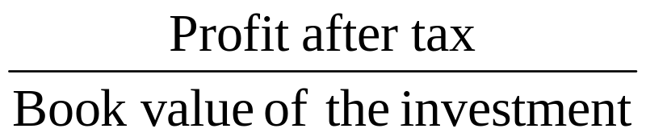
Accounting Rate of Return
The accounting rate of return, also called the average rate of return is defined as

Slide 38
Year | Book Value of Fixed Investment | Profit after tax
1 | 90000 | 20000
2 | 80000 | 22000
3 | 70000 | 24000
4 | 60000 | 26000
5 | 50000 | 28000

Slide 39
The accounting rate of return is
1/5(20,000+22000+24000+26000+28000)
1/5(90000+80,000+70,000+60,000+50,000)
= 34 %
Obviously the higher the accounting rate of return the better the project.In general projects which have an accounting rate equal to or greater than a pre specified cutoff rate of return- which is usually 10% and 30% are accepted; others are rejected.

Slide 40
Benefit Cost Ratio
There are two ways of defining the relationship between benefits and costs
Benefit- Cost ratio: BCR= PVB/I
Net Benefit- Cost Ratio: NBCR=(PVB-I)/I
= BCR-1
PVB= Present value of benefits
I = Initial investment

Slide 41
Illustration: Let us consider a project which is being evaluated by a firm that has a cost of capital of 12%
 | Rs100000
Year 1 | 25000
Year 2 | 40000
Year 3 | 40000
Year 4 | 50000

Slide 42
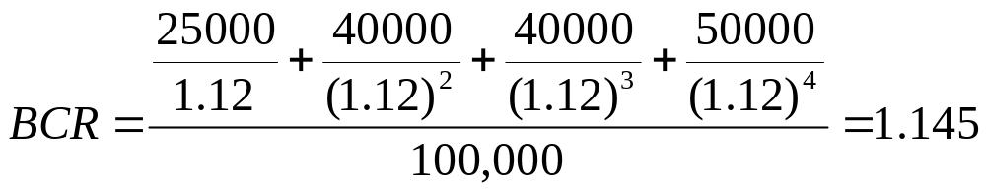
The benefit cost ratio measures for this project are
NBCR=BCR-1=0.145
When BCR
>1
=1
<1
Or NBCR
>0
=0
<0
Rule is
Accept
Indifferent
Reject

Slide 43
Problem1
The expected cash flows of a project are as follows
The cost of capital is 12%.
Calculate the followinga) NPV
b) benefit-cost ratio
c) IRR d) payback period e) discounted payback period.
Year | Cash flow
0 | -100000
1 | 20000
2 | 30000
3 | 40000
4 | 50000
5 | 30000

Slide 44
Problem 2
Sulabh International is evaluating a project whose expected cash flows are as follows
What is the NPV of the project, if discount rate is 14%
What is the NPV of the project if the discount rate is 12% for 1year and rises every year by 1 %.
Year | Cash flow
0 | -1000000
1 | 100000
2 | 200000
3 | 300000
4 | 600000

